Slide 1

FitTipz
Lucas Trog
Shadrach Roper
Carlos Contreras
Jake DiPrenda
Epsilon
LOGO HERE
F
T

Slide 2
Core Functions
Fitz Storage
Advanced Search
TipzTips
(Recommendations
Based Off
Previous Purchases)
FitTipz is a wardrobe management tool that stores and organizes data on user outfits.
Enables users to see clothing as 3D models before purchasing, and acts as a virtual wardrobe for any occasion.
This application aims to facilitate in finding, and purchasing products under user criteria. Sometimes alternating between current wardrobe and items you are looking to buy.
FitTipz
Visual Fitz
AI outfit Creator
Budget & redirection function to seller website)

Slide 3
Search Engine Settings
Garment - Type of garment, pants, shirts, jackets
Gender - M / F / M & F
Sizing - XS/ S / M / L / XL / XXL+
Pricing - Low to High / High to Low/ Best-selling / On-sale now
Quality - Most positive feedback over amount of sales per item.
Brands - List of brands includes Sportswear and clothes
Insulation - Thermal, Lightwear , Outer-wear, Exercise, Formal,
On top of this, the software will apply the 3D model on top of the model data provided. This way the user can build an outfit on the fly

Slide 4
Advanced Search &buy
1
2
3
4
Identify
Locate alike
Try on
Purchase
Advanced search helps find garments by criteria; Gender , Sizing, Brand name, Insulation ,Pricing , and overall item quality.
Have a photo? Submit it to have the system find the items or items like it.
Once criteria is provided, if the search is too narrow the system will show the user similar items/garments.
Similarly it can compare prices, discounts and sales.
If the item is in the system registry or a picture is uploaded using our picture template. The item can be ‘tried on’ to your 3D model to see how it would look on the desired model, or body shape.
Items available locally will be designated as such (location services)
Items can be marked as ‘in wardrobe’ , or a purchase can be made through the site (FitTipz’s or seller).

Slide 5

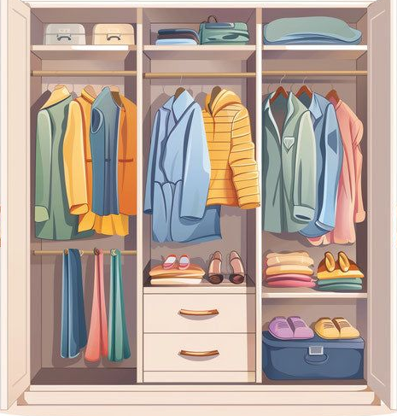


Fitz Storage
STORE
Track
Log
Randomize
Digital closet where users can categorize outfits by type, season, brand and more.
Supports item tags, labels, notes. Items tagged allow for user experience to be better catered.
Users may track worn and bought items, display a cost-per-wear price.
Reminds user of items not worn in a while.
In the back end;
Data stored for item visualization will be paired with data available outside the app, in order to better produce 3D renderings of items between users.
Allows the user to generate randomized outfits based on ‘in-wardrobe’ items.
Users can lock specific items to create semi-random looks.

Slide 6
VisualFitz: Two Types of Visual Standards – Standard 3D & Ultra 3D
Standard 3D;
Steps for Creation Standard 3d:
Take photos for Three different Angles
Front ( 0 degrees)
Side (90 degrees
Back ( 180 degrees)
Positioning for the photos:
Head should be front and center.
Arm and legs should be spread at a 45-degree angle on each side.
Hands should be open and feet should point outward
Upload Images:
Upload your images to the application for processing
Pick a Garment of Your Choice
After uploading, select the garment to finalize the effect.

Slide 7
AI Outfit Creator
The outfit creator is able to give suggestions based off user submitted criteria. Using generative AI FitTipz will be able to create a sample outfit using data imputed by the user.
The user can enter a prompt specifying what they are looking for(style, size, theme, occasion, etc). Using their provided 3D model, FitTipz will present them with an image in the generated outfit.
Whereas VisualFitz is intended for virtually trying on a specific garment, the outfit creator is designed to give the user a more broad idea of whatever they are looking for.

Slide 8
TipzTips
TipzTips tracks user’s past purchases to recommend future ones.
TipzTips tracks the items purchased and finds items with similar qualities to those purchased(brand, size, cut).
This is done to help provide a more streamlined process for returning users as well as provide them with a more personalized experience.

Slide 9
Budget & Redirection function to seller website)
Budget function:
The system asks you your budget range, and if you are not sure your exact budget, you can simply respond to the system low, median, or high; and it will give you a low range such as $0 - $50, median range $50 - $150, and high range $150 - $400, or no budget which would be a 0 or greater range. At some area of the application we will place a budget number and that number would change depending on if a user decides to add that item to their ‘cart’ which is where all of the item values are added up to a total. The user can delete or add items to that ‘cart’.
Redirection Function:
Simply, this function allows the user to be able to purchase the item they want on the sellers webpage. Once all of the users items are in their “cart”, the user can click on the stock image or the name of the item. Both containing a link, which will redirect them to the seller. Then through there the user can make their desired purchases.

Slide 10
Questions
How does 3D View work?
How can an AI create your outfit?
App will be using photos from or 3D rendering algorithms. Will create 180 view of item
The AI will learn your likes, dislikes and use your saved wardrobe items to mix something fresh for you
Will I be able to categorize my owned items?
How will you ensure user data safety?
All items, can be categorized by type, brand season , color and more.
FitTipz will follow all data-safety protocols.

